Slide 1

K-12 Microelectronic Workshop Arduino Programming
1 struct instructor {
2 String name = “Yi Liu”;
3 String department = “Mechanical Engineering”;
4 String university = “University of Vermont”;
5 }

Slide 2
Contents
3. Arduino Basic Programming and Interfacing
3.1 Using if — control an LED
3.2 Using for — a breathing LED
3.3 Summary

Slide 3
3.1 Using if — control an LED
4_IF_SerialRead_BlinkLED.ino — setup()
1 const int ledPin = 13;
2 String command;
3
4 void setup() {
5 pinMode(ledPin, OUTPUT);
6 Serial.begin(9600);
7 Serial.println(“Enter a command: ON or OFF”);
8 }

Slide 4
3.1 Using if — control an LED
4_IF_SerialRead_BlinkLED.ino — loop()
10 void loop() {
11 if (Serial.available() > 0) {
12 command = Serial.readStringUntil(‘\n’);
13
14 if (command == “ON”) {
15 digitalWrite(ledPin, HIGH);
16 Serial.println(“LED is ON”);
17 }
18
19 if (command == “OFF”) {
20 digitalWrite(ledPin, LOW);
21 Serial.println(“LED is OFF”);
22 }
23 }
24 }

Slide 5

3.1 Using if — control an LED
Syntax:
if (condition) {
// code to execute if the condition is true
}
if is a selection statement keyword
condition: a bool expression, true or false
if true, the code in the {} will be executed
if false, the code in the {} will be skipped

Slide 6

3.1 Using if — control an LED
11 if (Serial.available() > 0) {
checks if any bytes have arrived through the serial port
just like check how many mails in mailbox

Slide 7
3.1 Using if — control an LED
Syntax:
Serial.available()
returns: int, the number of bytes available to read

Slide 8
3.1 Using if — control an LED
12 command = Serial.readStringUntil(‘\n’);
Arduino reads characters into the previously defined command until it encounters the terminator, the newline character ‘\n’

Slide 9
3.1 Using if — control an LED
Syntax:
Serial.readStringUntil(terminator);
terminator: char, the character to search for
returns: String, contents in serial buffer before terminator

Slide 10
Contents
3. Arduino Basic Programming and Interfacing
3.1 Using if — control an LED
3.2 Using for — a breathing LED
3.3 Summary

Slide 11
3.2 Using for — a breathing LED
5_For_Analog_BreathingLED.ino — setup()
1 const int ledPin = 11;
2
3 void setup() {
4 pinMode(ledPin, OUTPUT);
5 }

Slide 12
3.2 Using for — a breathing LED
5_For_Analog_BreathingLED.ino — loop()
7 void loop() {
8 for (int bright = 0; bright < 256; bright++) {
9 analogWrite(ledPin, bright);
10 delay(20);
11 }
12
13 for (int bright = 255; bright > -1; bright--) {
14 analogWrite(ledPin, i);
15 delay(20);
16 }
17 }

Slide 13
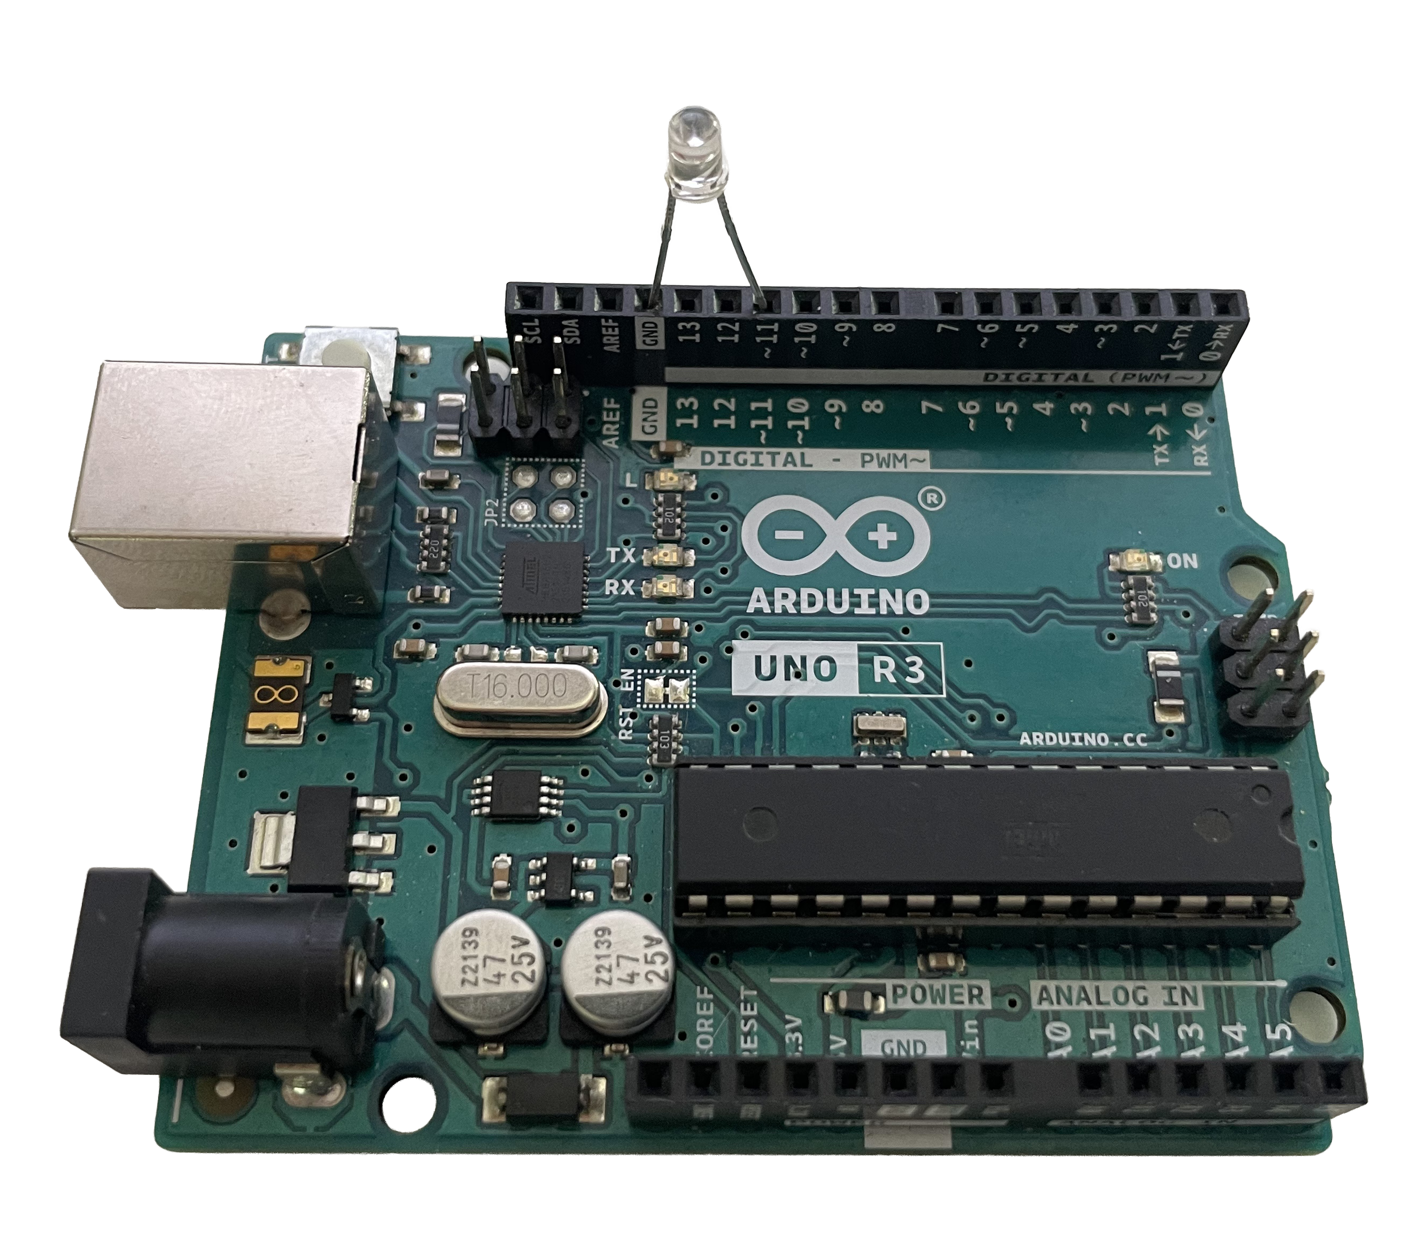
3.2 Using for — a breathing LED
GND
Pin 11

Slide 14
3.2 Using for — a breathing LED
Syntax:
for (initialization; condition; increment) {
// statement(s)
}
for is a loop statement keyword
initialization: run once before the loops starts
int
float
long
char
etc.

Slide 15
3.2 Using for — a breathing LED
Syntax:
for (initialization; condition; increment) {
// statement(s)
}
condition: checked before each loop iteration
if true, loop continuous
if false, loop ends
increment: runs after each iteration

Slide 16

3.2 Using for — a breathing LED
8 for (int bright = 0; bright < 256; bright++)
start at bright is 0
increase by 1
stop when reaching 256

Slide 17
3.2 Using for — a breathing LED
9 analogWrite(ledPin, bright);
write an analog value in range of 0 to 255 to a pin
e.g., controlling a LED or a motor
0: always off
255: always on or full speed
128: half brightness or half speed

Slide 18
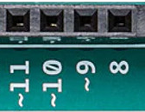
3.2 Using for — a breathing LED
Syntax:
analogWrite(pin, value)
pin: int, the analog-capable pin number
value: int, a value between 0 to 255
returns: void

Slide 19
Contents
3. Arduino Basic Programming and Interfacing
3.1 Using if — control an LED
3.2 Using for — a breathing LED
3.3 Summary

Slide 20
3.3 Summary
control statement
if (condition) {}
for (initialization; condition; increment) {}
analog I/O
analogWrite(pin, value)
communication
Serial.available()
Serial.readStringUntil(terminator);

Slide 21

Question
How to control LED ON, OFF, and Breathing?
Hint: A bool can be used to indicate if LED should be in breathing mode
bool ledBreathing = false;

Slide 22
K-12 Microelectronic Workshop Arduino Programming
1 Serial.println(“Thank you!”);

